Slide 1
MVP
USING
To Get The Power of
MVC
For Your
Web Forms Project

Slide 2

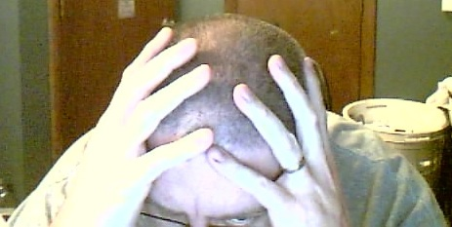



Project Lead Consultant
ABOUT ME
http://disruptivetheory.com
leebrandt@gmail.com
@leebrandt

Slide 3
My Motivation
MSDN Magazine Article on MVP from Jean-Paul Boodhoo
Blog Post From David Hayden on MVP and Unity IoC Container
Notes:
I was just like you (Web Forms Developers)
Had lots of hard-to-track-down bugs
Code-Behind files that were 3000 lines long
Read an article in MSDN 2006 (Jean-Paul Boodhoo)
Read an article by David Hayden
Ahhh clouds parted, skies opened… Nirvana
Then…
I went to talk at conferences and user groups about the MVC stuff I was learning
Most developers were “stuck” doing web forms development

Slide 4
Testability

Slide 5
S.O.L.I.D

Slide 6
Separation of Concerns

Slide 7
<%@ LANGUAGE = VBScript %>

Slide 8
.aspx
.aspx.cs
aspx.designer.cs

Slide 9
Patterns
Model View Controller
Model View Presenter
Model View View Model
Model View
America’s Next Top Model

Slide 10
View
Viewmodpresentroller
Model

Slide 11
The
Difference
NOT
Pieces
is
In the
But in How They Communicate
_

Slide 12
HTTP Response
HTTP Request
View
Controller
Data
(Supervising Controller)
Model

Slide 13
http Request/Response
View
Presenter
(Passive View)
Model

Slide 14
http Request/Response
.aspx
.aspx.cs
aspx.designer.cs
View
Presenter
(Passive View)
Model

Slide 15
I See Your
Lips
STILL
Moving, But You
Still Haven’t Said Anything
SHOW ME SOME CODE FAT MAN!!!

Slide 16
Build
Design
Code
Test
Deploy
In Summary
Notes:
Just because you can’t use MVC at your job, doesn’t mean you’re “stuck” with webforms
Testability
Separation of concerns
SOLID

Slide 17


